Slide 1

Chapter
6
Analyzing Consumer Markets

Slide 2
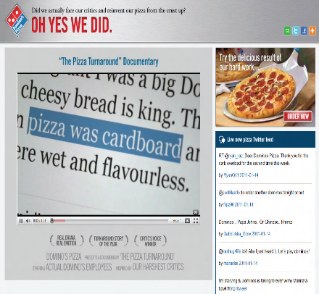
Learning Objectives
How do consumer characteristics influence buying behavior?
What major psychological processes influence consumer responses to the marketing program?
How do consumers make purchasing decisions?
In what ways do consumers stray from a deliberative, rational decision process?

Slide 3
What Influences Consumer Behavior?
Consumer behavior
  The study of how individuals, groups, and organizations select, buy, use, and dispose of goods, services, ideas, or experiences to satisfy their needs and wants
  Influenced by cultural, social, and personal factors
Notes:
Marketers must fully understand both the theory and the reality of consumer behavior.

Slide 4

What Influences Consumer Behavior?
Cultural factors
  Culture
  Subcultures
  Social classes
Notes:
Culture, subculture, and social class are particularly important influences on consumer buying behavior. Culture is the fundamental determinant of a person’s wants and behavior.
Each culture consists of smaller subcultures that provide more specific identification and socialization for their members. Subcultures include nationalities, religions, racial groups, and geographic regions.
Virtually all human societies exhibit social stratification, most often in the form of social classes, relatively homogeneous and enduring divisions in a society, hierarchically ordered and with members who share similar values, interests, and behavior.

Slide 5
What Influences Consumer Behavior?
Social factors
Reference groups
Cliques
Family
Roles and status
Notes:
In addition to cultural factors, social factors such as reference groups, family, and social roles and statuses affect our buying behavior.
A person’s reference groups are all the groups that have a direct (face-to-face) or indirect influence on their attitudes or behavior.
Cliques are small groups whose members interact frequently.
The family is the most important consumer buying organization in society, and family members constitute the most influential primary reference group.
We each participate in many groups—family, clubs, organizations—and these are often an important source of information and help to define norms for behavior. We can define a person’s position in each group in terms of role and status. A role consists of the activities a person is expected to perform. Each role in turn connotes a status.

Slide 6

Reference Groups
Membership groups
  Primary vs. secondary
Aspirational groups
Dissociative groups
Opinion leader
Notes:
Groups having a direct influence are called membership groups. Some of these are primary groups with whom the person interacts fairly continuously and informally, such as family, friends, neighbors, and coworkers. People also belong to secondary groups, such as religious, professional, and trade-union groups, which tend to be more formal and require less continuous interaction.
Aspirational groups are those a person hopes to join; dissociative groups are those whose values or behavior an individual rejects.
Where reference group influence is strong, marketers must determine how to reach and influence the group’s opinion leaders. An opinion leader is the person who offers informal advice or information about a specific product or product category, such as which of several brands is best or how a particular product may be used.

Slide 7
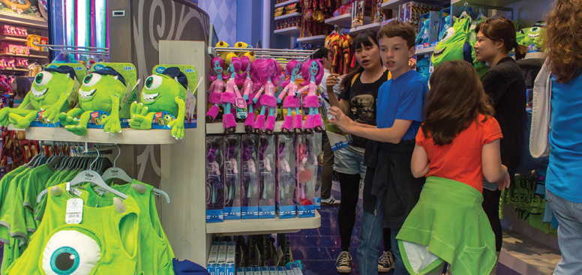

Family
Family of orientation vs. family of procreation
Notes:
There are two families in the buyer’s life. The family of orientation consists of parents and siblings. From parents a person acquires an orientation toward religion, politics, and economics and a sense of personal ambition, self-worth, and love. A more direct influence on everyday buying behavior is the family of procreation—namely, the person’s spouse and children. In the United States, in a traditional husband–wife relationship, engagement in purchases has varied widely by product category. The wife has usually acted as the family’s main purchasing agent, especially for food, sundries, and staple clothing items. Now traditional purchasing roles are changing, and marketers would be wise to see both men and women as possible targets.

Slide 8

What Influences Consumer Behavior?
Personal factors
  Age/stage in life cycle
  Occupation and economic circumstances
  Personality and self-concept
  Lifestyle and values
Notes:
Our taste in food, clothes, furniture, and recreation is often related to our age. Consumption is also shaped by the family life cycle and the number, age, and gender of people in the household at any point in time. In addition, psychological life-cycle stages may matter. Adults experience certain passages or transformations as they go through life.
Marketers try to identify the occupational groups that have above-average interest in their products and services and even tailor products for certain occupational groups: Computer software companies, for example, design different products for brand managers, engineers, lawyers, and physicians. As the recent prolonged recession clearly indicated, both product and brand choice are greatly affected by economic circumstances like spendable income (level, stability, and pattern over time), savings and assets (including the percentage that is liquid), debts, borrowing power, and attitudes toward spending and saving.
By personality, we mean a set of distinguishing human psychological traits that lead to relatively consistent and
enduring responses to environmental stimuli including buying behavior. We often describe personality in terms of such traits as self-confidence, dominance, autonomy, deference, sociability, defensiveness, and adaptability.
Consumers often choose and use brands with a brand personality consistent with their actual self-concept (how we view ourselves), though the match may instead be based on the consumer’s ideal self-concept (how we
would like to view ourselves) or even on others’ self-concept (how we think others see us).
People from the same subculture, social class, and occupation may adopt quite different lifestyles. A lifestyle is a person’s pattern of living in the world as expressed in activities, interests, and opinions.

Slide 9
Key Psychological Processes
Motivation
Memory
Perception
Emotions
Learning
Notes:
Marketing and environmental stimuli enter the consumer’s consciousness, and a set of psychological processes combine with certain consumer characteristics to result in decision processes and purchase decisions. The marketer’s task is to understand what happens in the consumer’s consciousness between the arrival of the outside marketing stimuli and the ultimate purchase decisions. Five key psychological processes—motivation, perception, learning, emotions, and memory—fundamentally influence consumer responses.

Slide 10
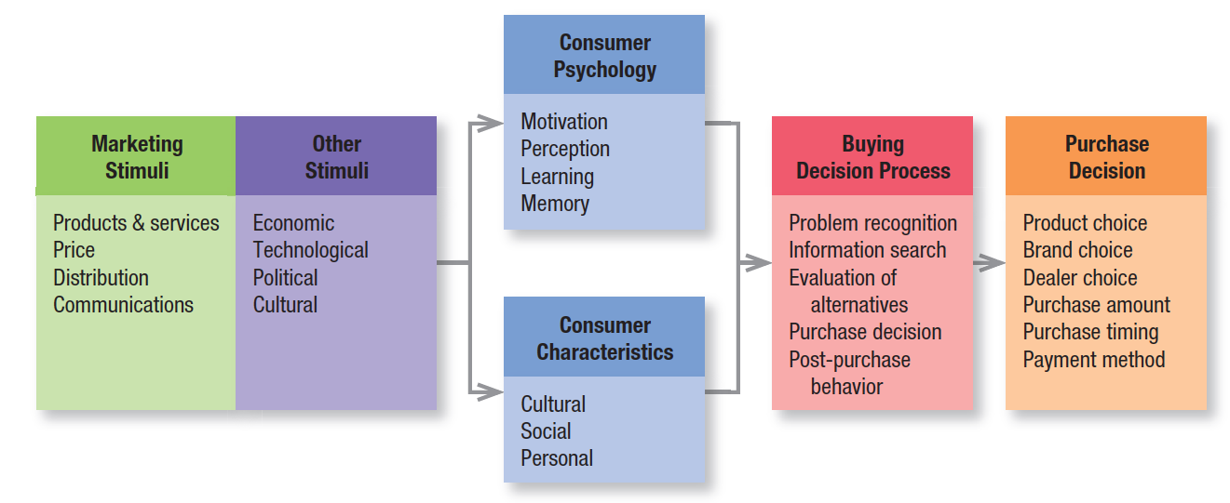
Figure 6.1
Model Of Consumer Behavior
Notes:
The starting point for understanding consumer behavior is the stimulus-response model shown in Figure 6.1.

Slide 11

Key Psychological Processes
Motivation
  A need becomes a motive when it is aroused to a sufficient level of intensity to drive us to act

Slide 12
Motivation
Freud’s
Theory
Behavior
is guided by
subconscious
motivations
Maslow’s
Hierarchy
of Needs
Behavior
is driven by
lowest,
unmet need
Herzberg’s
Two-Factor
Theory
Behavior is
guided by
dissatisfiers
and
satisfiers
Notes:
Sigmund Freud assumed the psychological forces shaping people’s behavior are largely unconscious and that a person cannot fully understand his or her own motivations.
Abraham Maslow sought to explain why people are driven by particular needs at particular times. His answer is that human needs are arranged in a hierarchy from most to least pressing—from physiological needs to safety needs, social needs, esteem needs, and self-actualization needs (see Figure 6.2). People will try to satisfy their most important need first and then move to the next.
Frederick Herzberg developed a two-factor theory that distinguishes dissatisfiers (factors that cause dissatisfaction) from satisfiers (factors that cause satisfaction). The absence of dissatisfiers is not enough to motivate a purchase; satisfiers must be present. For example, a computer that does not come with a warranty is a dissatisfier. Yet the presence of a product warranty does not act as a satisfier or motivator of a purchase because it is not a source of intrinsic satisfaction. Ease of use is a satisfier.

Slide 13
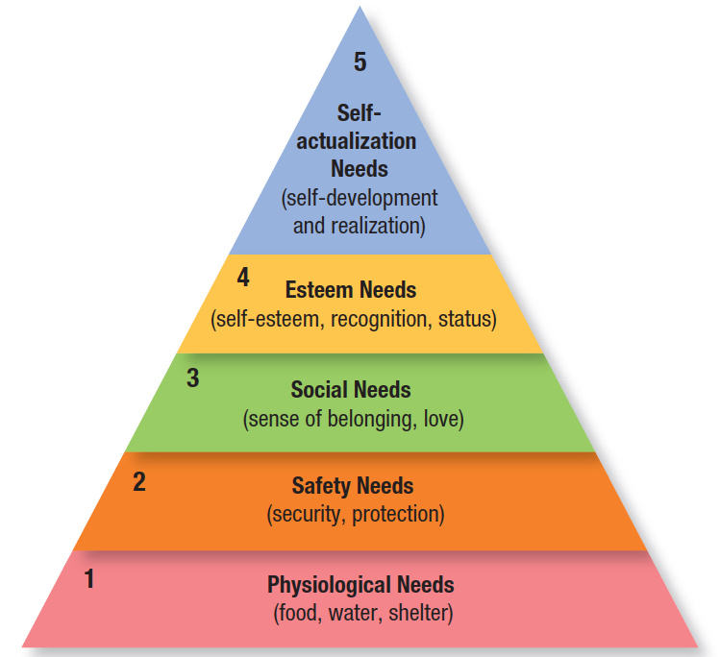
Figure 6.2
Maslow’s Hierarchy Of Needs
Notes:
In Maslow’s theory, people will try to satisfy their most important need first and then move to the next. For example, a starving man (need 1) will not take an interest in the latest happenings in the art world (need 5), nor in the way he is viewed by others (need 3 or 4), nor even in whether he is breathing clean air (need 2), but when he has enough food and water, the next most important need will become salient.

Slide 14

Key Psychological Processes
Perception
  The process by which we select, organize, and interpret information inputs to create a meaningful picture of the world
Notes:
A motivated person is ready to act—how is influenced by his or her perception of the situation. In marketing, perceptions are more important than reality because they affect consumers’ actual behavior.

Slide 15
perception
Selective attention
Selective distortion
Selective retention
Subliminal perception
Notes:
We screen most stimuli out—a process called selective attention. Selective attention means that marketers must work hard to attract consumers’ notice. People are more likely to notice stimuli that relate to a current need. People are more likely to notice stimuli they anticipate. People are more likely to notice stimuli whose deviations are large in relationship to the normal size of the stimuli.
Selective distortion is the tendency to interpret information in a way that fits our preconceptions. Consumers will often distort information to be consistent with prior brand and product beliefs and expectations. Selective distortion can work to the advantage of marketers with strong brands when consumers distort neutral or ambiguous brand information to make it more positive. In other words, coffee may seem to taste better, a car may seem to drive more smoothly, and the wait in a bank line may seem shorter, depending on the brand.
Most of us don’t remember much of the information to which we’re exposed, but we do retain information that supports our attitudes and beliefs. Because of selective retention, we’re likely to remember good points about a product we like and forget good points about competing products. Subliminal perception has long fascinated armchair marketers, who argue that marketers embed covert, subliminal messages in ads or packaging. Consumers are not consciously aware of them, yet they affect behavior.

Slide 16
Key Psychological Processes
Learning
  Induces changes in our behavior arising from experience
  Drive and cues
  Generalization and discrimination
Notes:
Most human behavior is learned, though much learning is incidental. Learning theorists believe learning is produced through the interplay of drives, stimuli, cues, responses, and reinforcement.
A drive is a strong internal stimulus impelling action. Cues are minor stimuli that determine when, where, and how a person responds.
A new company can enter the market by appealing to the same drives competitors use and providing similar cues because buyers are more likely to transfer loyalty to similar brands (generalization); or the company might design its brand to appeal to a different set of drives and offer strong cue inducements to switch (discrimination).

Slide 17

Key Psychological Processes
Emotions
  Many different kinds of emotions can be linked to brands
Notes:
Marketers are increasingly recognizing the power of emotional appeals—especially if these are rooted in some
functional or rational aspects of the brand. An emotion-filled brand story has been shown to trigger’s people desire to pass along things they hear about brands, through either word of mouth or online sharing. Firms are giving their communications a stronger human appeal to engage consumers in their brand stories.

Slide 18
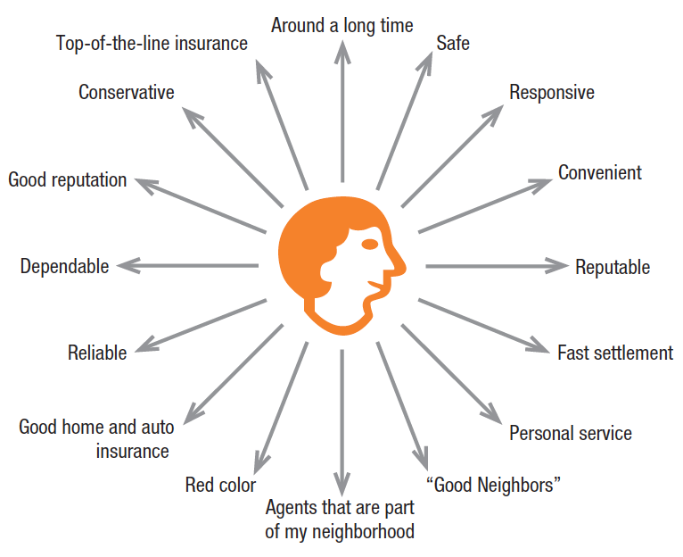
Key Psychological Processes
Memory
  Short-term vs. long-term memory
  Associative network memory model
  Brand associations
  Memory encoding
  Memory retrieval
Notes:
Cognitive psychologists distinguish between short-term memory (STM)—a temporary and limited repository
of information—and long-term memory (LTM)—a more permanent, essentially unlimited repository.
The associative network memory model views LTM as a set of nodes and links. Nodes are stored information connected by links that vary in strength. Any type of information can be stored in the memory network, including verbal, visual, abstract, and contextual. A spreading activation process from node to node determines how much we retrieve and what information we can actually recall in any given situation. Brand associations consist of all brand-related thoughts, feelings, perceptions, images, experiences, beliefs, attitudes, and so on, that become linked to the brand node.
Memory encoding describes how and where information gets into memory. The strength of the resulting association depends on how much we process the information at encoding (how much we think about it, for instance) and in what way. In general, the more attention we pay to the meaning of information during encoding, the stronger the resulting associations in memory will be.
Memory retrieval is the way information gets out of memory. The presence of other product information in memory can produce interference effects and cause us to either overlook or confuse new data. The time between exposure to information and encoding has been shown generally to produce only gradual decay. Information may be available in memory but not be accessible for recall without the proper retrieval cues or reminders.

Slide 19
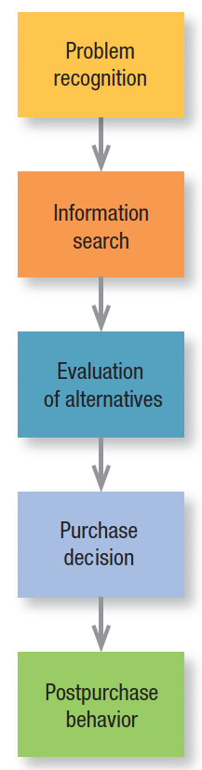
The Buying
Decision Process
The consumer typically passes through five stages
  Problem recognition
  Information search
  Evaluation of alternatives
  Purchase decision
  Postpurchase behavior
Notes:
Clearly, the buying process starts long before the actual purchase and has consequences long afterward. Some consumers passively shop and may decide to make a purchase from unsolicited information they encounter in the normal course of events. Consumers don’t always pass through all five stages—they may skip or reverse some. The model in Figure 6.4 provides a good frame of reference, however, because it captures the full range of considerations that arise when a consumer faces a highly involving or new purchase.

Slide 20

The Buying
Decision Process
Problem recognition
  The buyer recognizes a problem/need triggered by internal/external stimuli
Notes:
With an internal stimulus, one of the person’s normal needs—hunger, thirst, sex—rises to a threshold level and becomes a drive. A need can also be aroused by an external stimulus. Marketers need to identify the circumstances that trigger a particular need by gathering information from a number of consumers. They can then develop marketing strategies that spark consumer interest.

Slide 21
The Buying
Decision Process
Information search
  Personal sources
  Commercial sources
Public sources
Experiential sources
Notes:
The relative amount of information and influence of these sources vary with the product category and the buyer’s characteristics. Generally speaking, although consumers receive the greatest amount of information about a product from commercial—that is, marketer-dominated—sources, the most effective information often comes
from personal or experiential sources or public sources that are independent authorities.

Slide 22
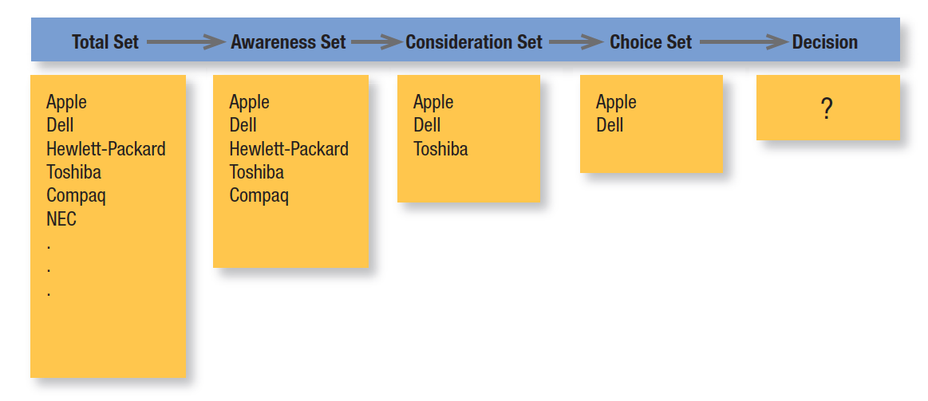
Figure 6.5
Sets Involved In Decision Making
Notes:
By gathering information, the consumer learns about competing brands and their features. The first box in Figure 6.5 shows the total set of brands available. The individual consumer will come to know a subset of these, the awareness set. Only some, the consideration set, will meet initial buying criteria. As the consumer gathers more information, just a few, the choice set, will remain strong contenders. The consumer makes a final choice from these. Marketers need to identify the hierarchy of attributes that guide consumer decision making in order to understand different competitive forces and how these various sets get formed. This process of identifying the hierarchy is called market partitioning.

Slide 23
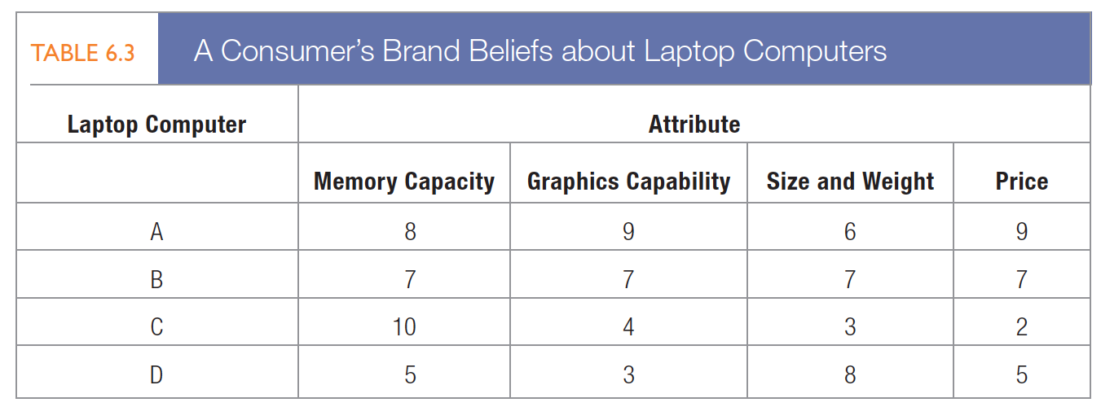
The Buying
Decision Process
Evaluation of alternatives
  Expectancy-value model
Notes:
How does the consumer process competitive brand information and make a final value judgment? Through experience and learning, people acquire beliefs and attitudes. These in turn influence buying behavior. A belief is a descriptive thought that a person holds about something. Just as important are attitudes, a person’s enduring favorable or unfavorable evaluations, emotional feelings, and action tendencies toward some object or idea.
The consumer arrives at attitudes toward various brands through an attribute-evaluation procedure, developing a set of beliefs about where each brand stands on each attribute. The expectancy-value model of attitude formation posits that consumers evaluate products and services by combining their brand beliefs—the positives and negatives—according to importance.
To find Linda’s perceived value for each laptop according to the expectancy-value model, we multiply her weights by her beliefs about each computer’s attributes. This computation leads to the following perceived values:
Laptop A = 0.4182 + 0.3192 + 0.2162 + 0.1192 = 8.0
Laptop B = 0.4172 + 0.3172 + 0.2172 + 0.1172 = 7.0
Laptop C = 0.41102 + 0.3142 + 0.2132 + 0.1122 = 6.0
Laptop D = 0.4152 + 0.3132 + 0.2182 + 0.1152 = 5.0
An expectancy-model formulation predicts that Linda will favor laptop A, which (at 8.0) has the highest perceived Value.

Slide 24
The Buying
Decision Process
Purchase decision
  Compensatory vs. noncompensatory models
Conjunctive heuristic
Lexicographic heuristic
Elimination-by-aspects heuristic
Notes:
The expectancy-value model is a compensatory model. With noncompensatory models of consumer choice, positive and negative attribute considerations don’t necessarily net out. Using the conjunctive heuristic, the consumer sets a minimum acceptable cutoff level for each attribute and chooses the first alternative that meets the minimum standard for all attributes. With the lexicographic heuristic, the consumer chooses the best brand on the basis of its perceived most important attribute. Using the elimination-by-aspects heuristic, the consumer compares brands on an attribute selected probabilistically—where the probability of choosing an attribute is positively related to its importance—and eliminates brands that do not meet minimum acceptable cutoffs.

Slide 25
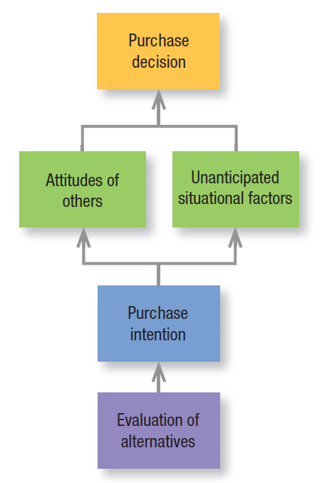
Intervening factors
Notes:
Even if consumers form brand evaluations, two general factors can intervene between the purchase intention and the purchase decision (see Figure 6.6). The first factor is the attitudes of others. The influence on us of another person’s attitude depends on two things: (1) the intensity of the other person’s negative attitude toward our preferred alternative and (2) our motivation to comply with the other person’s wishes. The more intense the other person’s negativism and the closer he or she is to us, the more we will adjust our purchase intention. The converse is also true. The second factor is unanticipated situational factors that may erupt to change the purchase intention.

Slide 26
Types of perceived risk
Functional risk
Physical risk
Time risk
Financial risk
Psychological risk
Social risk
Notes:
A consumer’s decision to modify, postpone, or avoid a purchase decision is heavily influenced by one or more types of perceived risk:
1. Functional risk—The product does not perform to expectations.
2. Physical risk—The product poses a threat to the physical well-being or health of the user or others.
3. Financial risk—The product is not worth the price paid.
4. Social risk—The product results in embarrassment in front of others.
5. Psychological risk—The product affects the mental well-being of the user.
6. Time risk—The failure of the product results in an opportunity cost of finding another satisfactory product.

Slide 27

The Buying
Decision Process
Postpurchase behavior
  Postpurchase satisfaction
  Postpurchase actions
  Postpurchase uses and disposal
Notes:
Satisfaction is a function of the closeness between expectations and the product’s perceived performance. If performance falls short of expectations, the consumer is disappointed; if it meets expectations, the consumer is satisfied; if it exceeds expectations, the consumer is delighted.
A satisfied consumer is more likely to purchase the product again and will also tend to say good things about the brand to others. Dissatisfied consumers may abandon or return the product. They may seek information that confirms its high value. They may take public action by complaining to the company, going to a lawyer, or complaining directly to other groups (such as business, private, or government agencies) or to many others online. Private actions include deciding to stop buying the product (exit option) or warning friends (voice option).
Marketers should also monitor how buyers use and dispose of the product (Figure 6.7). A key driver of sales frequency is product consumption rate—the more quickly buyers consume a product, the sooner they may be back in the market to repurchase it. If consumers throw the product away, the marketer needs to know how they dispose of it, especially if—like batteries, beverage containers, electronic equipment, and disposable diapers—it can damage the environment. There also may be product opportunities in disposed products.

Slide 28
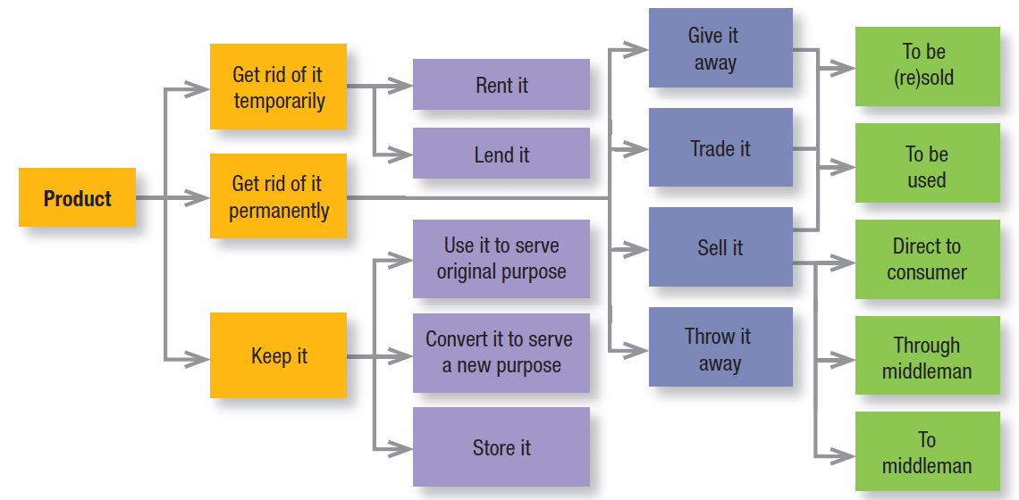
Figure 6.7
Customer Product Use/Disposal
Notes:
Marketers should also monitor how buyers use and dispose of the product (Figure 6.7).

Slide 29

Moderating Effects on Consumer Decision Making
Low-involvement Consumer Decision Making
Variety-Seeking Buying Behavior
Notes:
The expectancy-value model assumes a high level of consumer involvement, or engagement and active processing the consumer undertakes in responding to a marketing stimulus. We buy many products under conditions of low involvement and without significant brand differences. Consider salt. If consumers keep reaching for the same brand in this category, it may be out of habit, not strong brand loyalty. Evidence suggests we have low involvement with most low-cost, frequently purchased products. Marketers use techniques to try to convert a low-involvement product into one of higher involvement.
Some buying situations are characterized by low involvement but significant brand differences. Here consumers often do a lot of brand switching.

Slide 30

Behavioral Economics
Decision Heuristics
  Availability heuristic
  Representativeness heuristic
  Anchoring and adjustment heuristic
Framing
  Mental accounting
Notes:
One of the most active academic research areas in marketing over the past three decades has been behavioral decision theory (BDT). Behavioral decision theorists have identified many situations in which consumers make seemingly irrational choices.
1. The availability heuristic—Consumers base their predictions on the quickness and ease with which a particular example of an outcome comes to mind. If an example comes to mind too easily, consumers might overestimate the likelihood of its happening. For example, a recent product failure may lead consumers to inflate the likelihood of a future product failure and make them more inclined to purchase a product warranty.
2. The representativeness heuristic—Consumers base their predictions on how representative or similar the outcome is to other examples. One reason package appearances may be so similar for different brands in the same product category is that marketers want their products to be seen as representative of the category as a
whole.
3. The anchoring and adjustment heuristic—Consumers arrive at an initial judgment and then adjust it—sometimes only reluctantly—based on additional information. For services marketers, a strong first impression is critical to establishing a favorable anchor so subsequent experiences will be interpreted in a more
favorable light.
Decision framing is the manner in which choices are presented to and seen by a decision maker. Mental accounting describes the way consumers code, categorize, and evaluate financial outcomes of choices. Mental accounting is based on a set of core principles:
1. Consumers tend to segregate gains. When a seller has a product with more than one positive dimension, it’s desirable to have the consumer evaluate each dimension separately. Listing multiple benefits of a large industrial product, for example, can make the sum of the parts seem greater than the whole.
2. Consumers tend to integrate losses. Marketers have a distinct advantage in selling something if its cost can be added to another large purchase. House buyers are more inclined to view additional expenditures favorably given the already high price of buying a house.
3. Consumers tend to integrate smaller losses with larger gains. The “cancellation” principle might explain why withholding taxes from monthly paychecks is less painful than making large, lump-sum tax payments—the smaller withholdings are more likely to be overshadowed by the larger pay amount.
4. Consumers tend to segregate small gains from large losses. The “silver lining” principle might explain the popularity of rebates on big-ticket purchases such as cars.

Slide 31
